Slide 1
INTERFACES
Prepared by Dr Syed Khaldoon Khurshid
Powered by Brilliant Application

Slide 2
Mayor Jing is in her office, and she remembers she needs to review all the Fire Department memos for a presentation to City Council. She could go and find all the memos herself, but Mayor Jing isn't a micromanager. She has grouped several employees as members of the Records Office—an abstraction—and she can ask the Records Office to do things.
She picks up her phone, hits the button for her Records Office, and says “get me all the Fire Department memos so I can read them over lunch.”
Later, when she leaves for lunch, all the memos her office has written about the Fire Department are waiting for her.

Slide 3
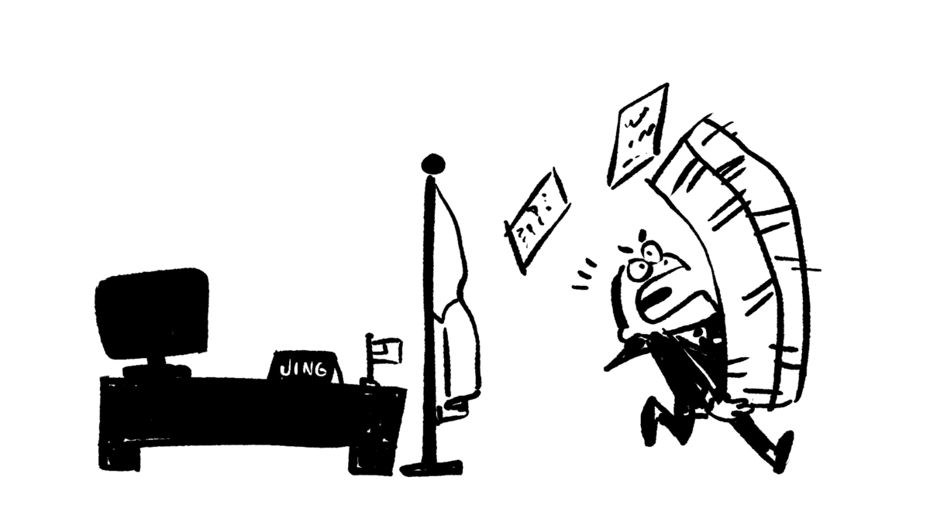

Slide 4
Mayor Jing has just used another form of abstraction. There was a problem: she needed all the Fire Department memos and she did not have them. She was able to get a solution to her problem, and she didn't need to know how that solution works!

Slide 5
Mayor Jing knows that she can ask her Records Office to do a certain set of things: for example, she can ask them to search for a group of records on a particular topic or all the records from a certain date. But she'd never ask the Records Office to fight a fire! The things that Mayor Jing can ask form a sort of menu. When you have an abstraction, the menu tells you what you can ask for and gives you some idea of what you will get back.
The menu of the Records Office isn't so different from the menu at the restaurant Mayor Jing eats lunch at. There are a limited set of requests you can make, and when Mayor Jing makes one of those requests, she expects to get something relatively specific back.

Slide 6
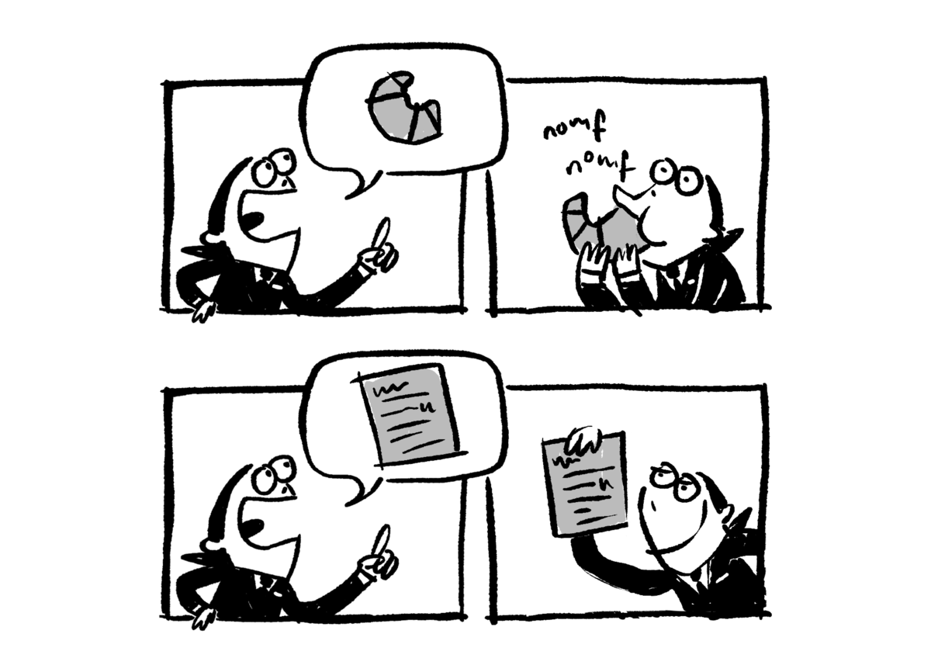
The burrito restaurant and the Records Office are two kinds of abstractions. In computer science, we call the menu that an abstraction offers its interface.
In computer science, the interface is often called an API. That officially stands for Application Programming Interface. However, the only important letter to remember is the "I," standing for "interface."

Slide 7
One of the important properties of an interface is that it's possible to use it without knowing how it works. Mayor Jing may not know how to cook the thing she is eating for lunch, but she's still able to order it!
It is the case that somebody needs to know how to prepare Mayor Jing's restaurant order. Someone also needs to know how to get all the Fire Department memos. But this is a (potentially complicated) detail that gets hidden from Mayor Jing, allowing her to think about other things. This is one of the benefits of abstraction!
It is also important for computer scientists that when there is an interface, there may be more than one implementation.
Let's look back at Mayor Jing's request for all the Fire Department memos, and think about how that request could be implemented.

Slide 8
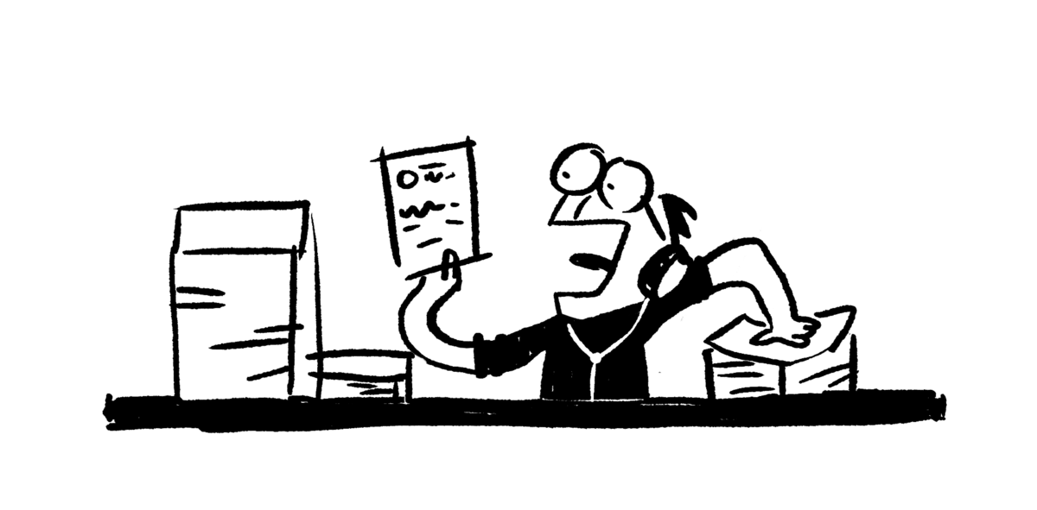
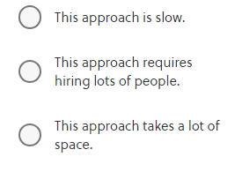
Maybe Mayor Jing was employing the extremely patient, Farhad, who fulfilled the request by looking through every memo one by one to collect all the ones whose topic was the Fire Department.
What's the biggest downside of this approach?
Correct answer: This approach is slow.
Farhad's method will get the job done, but it takes a lot of time!

Slide 9
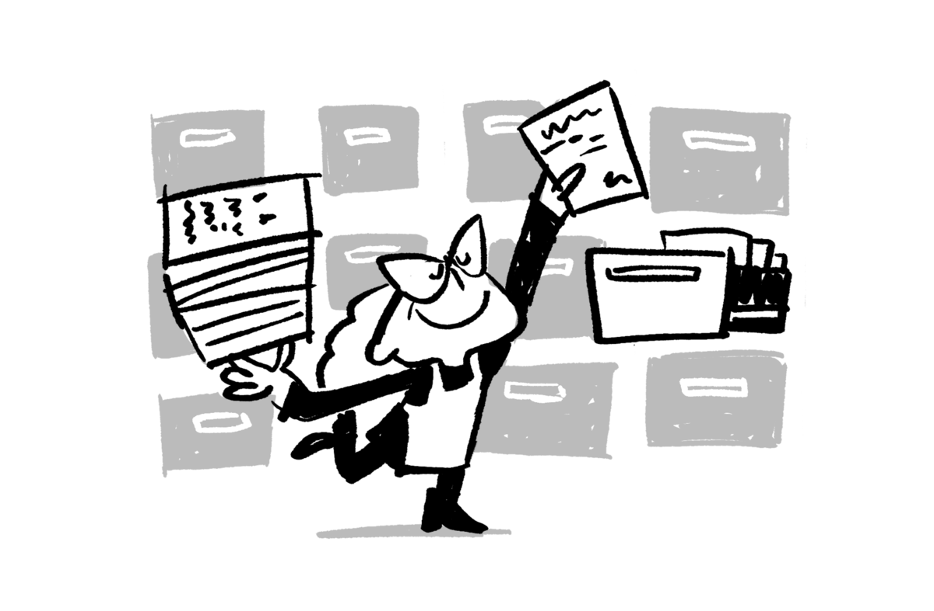
As an alternative, maybe Tiye the librarian has taken a leave from her library job to work for Mayor Jing.
Inspired by her library's old card catalog, Tiye has filled many rooms with copies of every memo stored in every conceivable order: one copy of all memos ordered by date, one ordered by author, one ordered by recipient, one ordered by title, and one ordered by topic.

Slide 10
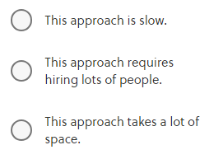
This means she can go to the topic-ordered file and very quickly find all the memos about the Fire Department.
What's the biggest downside of this approach to the problem?

Slide 11
Correct answer: This approach takes a lot of space.
Tiye's approach works, but it will fill a lot of space with filing cabinets!
It would be more reasonable if Tiye tried a more modern approach of storing the separate indexes in a computer database. But remember that, in computer science, "space" is used to describe the use of computer storage. Storing those extra copies of information in another order to help with faster search uses lots of computer storage, even if it wouldn't take nearly as much physical space.

Slide 12
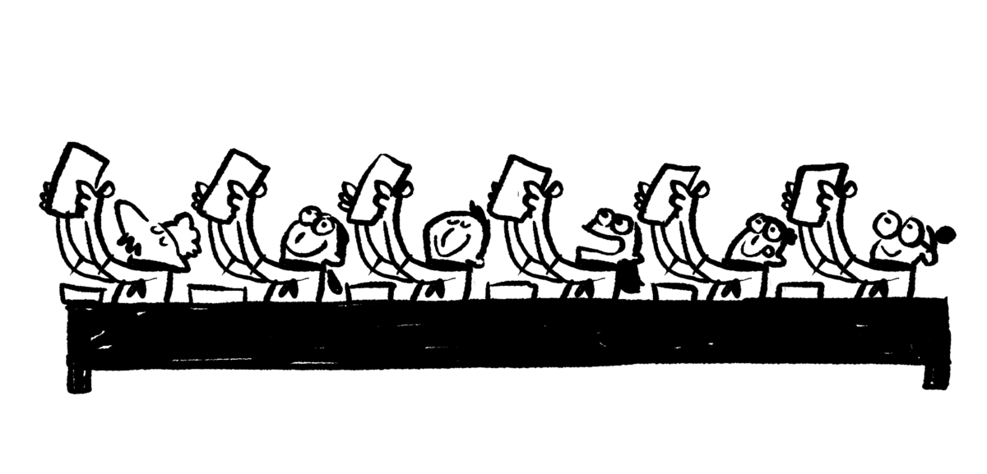
What if the Mayor's Office has gotten help by hiring Pierre and his embarrassingly parallel baking assistants? They can easily divide all the memos among them and find the ones that are about the Fire Department.

Slide 13
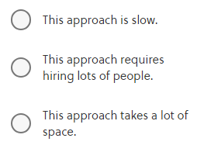
What's the biggest downside of this approach to the problem?
Correct answer: This approach requires hiring lots of people.
Pierre and his assistants can get the job done quickly, but there are lots of them!

Slide 14
We've seen three very different ways of implementing Mayor Jing's request for all the Fire Department memos. But from Mayor Jing's perspective, all of these had the same interface: she asked the Records Office for all the Fire Department memos, and she got all the memos back.
This will probably work fine for Mayor Jing… until it stops being fine.
Maybe the department's personnel costs are too high, and Hans needs to downsize to a less embarrassing number of assistants.

Slide 15
Maybe the City Council is angry that their chambers are full of Tiye's filing cabinets, and she needs to back off a bit.
Maybe Mayor Jing isn't able to get answers to her questions in a timely fashion, and Farhad needs to get more organized.
Figuring out the right solution always requires Mayor Jing to look through the interface for a bit to fix the problem. But once she's fixed the problem in a way that meets her priorities and needs, she can go back to treating her Records Office as an abstraction.

Slide 16
In this example, we've seen how all of our computational problem-solving strategies can approach a simple problem: finding a small set of Mayor Jing's Fire Department memos.
In computer science, we're frequently using abstraction to allow ourselves to focus on a small part of a very complex system. Once we've concentrated on a small part of the big system, we can think about using other problem-solving strategies to attack the more manageable problem.

Slide 17
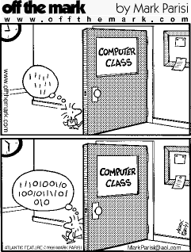
C H A P T E R 1
Data Storage (& Representation)
Prepared by Dr Syed Khaldoon Khurshid

Slide 18
1.1 Bits and Their Storage
Information represented as patterns of bits (binary digits)
A bit is either 0 or 1 (true or false)
Meaning of bit(-stream)s varies
numeric values, characters, images, sounds…
Requires a device that can be in one of two states (& remain in that state as long as needed)
Flip-flop circuits

Slide 19
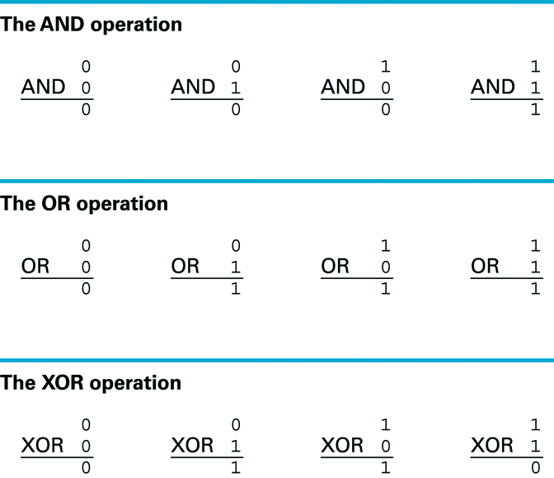
1.1 The Boolean Operations AND, OR, and XOR
Note: AND and OR exist in natural language!

Slide 20
Example: Boolean Operations and natural language
Khalid has gone to cafe.
AND Umer has gone to School.
THEN their mother can do house chores.
Result:
Both has to go to school for their mother to do chores of the house.
Check with OR operation.

Slide 21
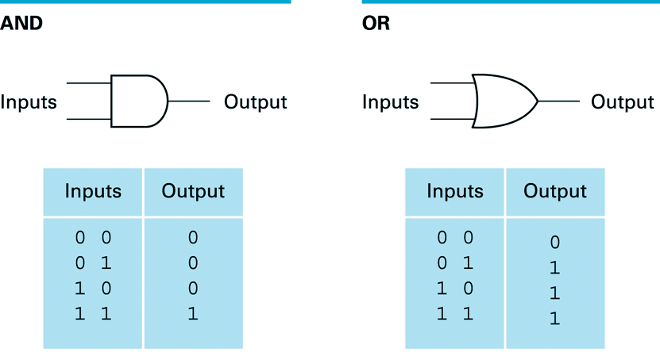
1.1 AND and OR Gates
‘0’ and ‘1’ Digits are representing “Voltage levels” ?

Slide 22
Flip Flop circuit:
Flip-flops and latches are fundamental building blocks of digital electronics systems used in computers, communications, and many other types of systems.
A flip flop circuit that produces an output value of ‘0’ or ‘1’ that remains constant until a temporary pulse from another circuit causes it to shift to the other value.

Slide 23
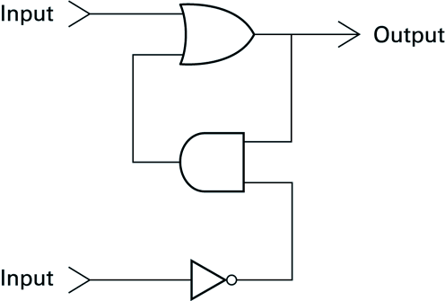
1.1 A Simple Flip-flop Circuit
As long as both inputs remain 0: output does not change
Temporarily placing 1 on upper input => output = 1
Temporarily placing 1 on lower input => output = 0
So: output flip-flops between 2 values under external control

Slide 24
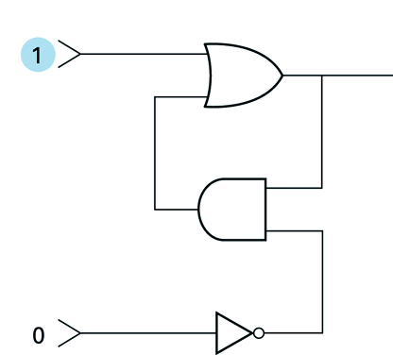
1.1 Setting the Output of a Flip-flop to 1

Slide 25
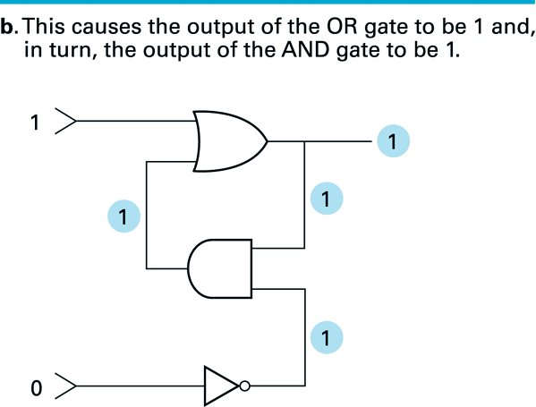
1.1 Setting the Output of a Flip-flop to 1 (cont’d)

Slide 26
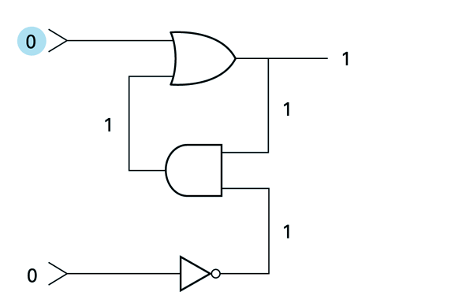
1.1 Setting the Output of a Flip-flop to 1 (cont’d)

Slide 27
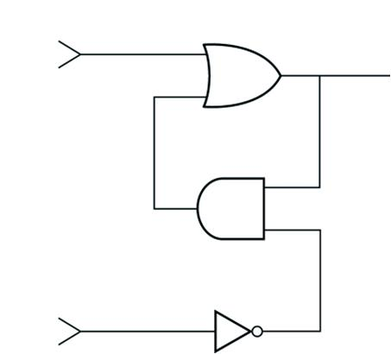
Temporarily placing ‘1’ on the lower end of the flip flop (retaining previous output):

Slide 28
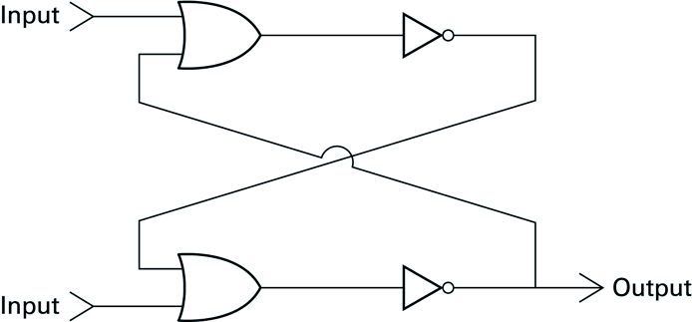
Another way of constructing Flip-Flop:
SR latch (Set-Reset) Latch
Write outputs & sequence of steps on the basis of following inputs?
upper input = 1 and lower input = 0
upper input = 0 and lower input = 0
Solve it...its solution in
The next week.

Slide 29
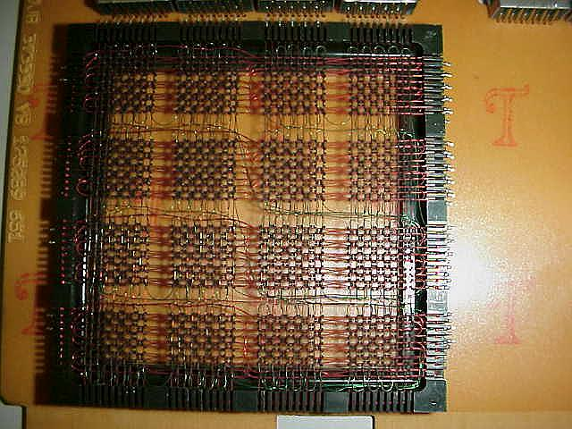
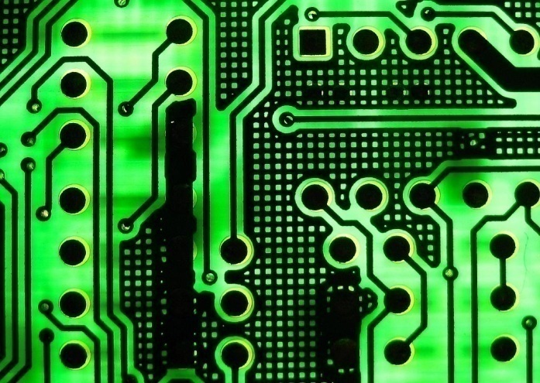
Other Storage Techniques
Cores
Magnetic-core memory was the predominant form of random-access computer memory for 20 years between about 1955 and 1975. Such memory is often just called core memory, or, informally, core.
Core will be Magnetized in one of the two directions
Retain Data after Machine is switched off
Obsolete
Capacitors->Millions-> Chip
A capacitor can store electric energy when it is connected to its charging circuit. And when it is disconnected from its charging circuit, it can dissipate that stored energy, so it can be used like a temporary battery. ... In car audio systems, large capacitors store energy for the amplifier to use on demand.
Charge or Discharge Plates
Charges on capacitors dissipate
Refresh Circuit
Core Memory from an IBM 2821
Circuit Board with capacitors
Dynamic Memory

Slide 30
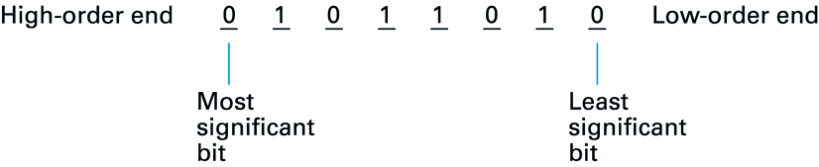
1.2 Main Memory
Large collection of circuits, each capable of storing a single bit
Arranged in small cells, typically of 8 bits each (a.k.a.: byte)

Slide 31
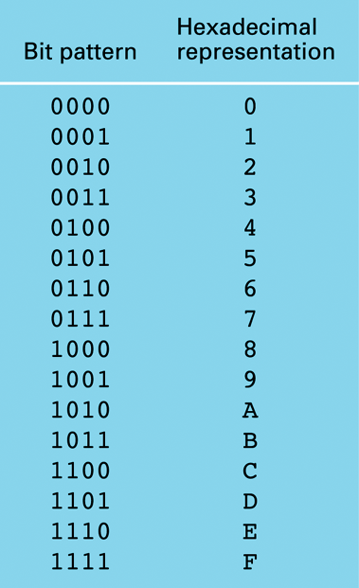
1.1 The Hexadecimal Coding System
Bit-streams often very long
For simplicity of notation:
Hexadecimal system
Reduces 4 bits to 1 symbol
Especially important in assembly language programming

Slide 32
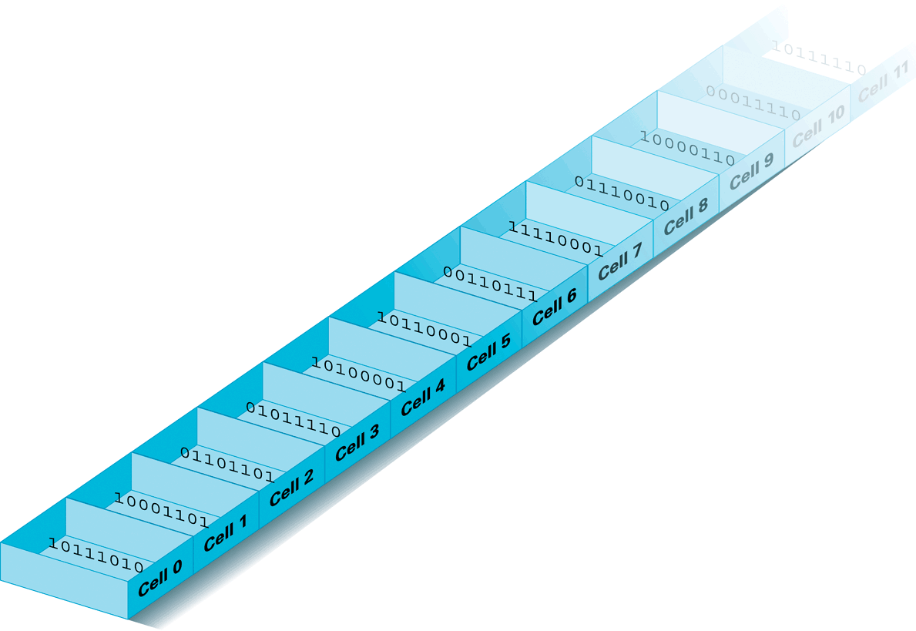
1.2 Arrangement of Memory Cells
Each cell has a unique address
Longer strings stored by using consecutive cells
Read and Write Operations
value = 01101101
RAM (random access memory)
address = 2 = 0x02

Slide 33
Chapter 1: Problem 6 How many cells can be in a computer’s main memory if each cell’s address can be represented by 3 hexadecimal digits?
Three digits:
3 positions, each of which can be one of 16 values (from the range: 0, 1, …, 9, A, B, C, D, E, F)
smallest: 000 = 0×16² + 0×16¹ + 0×16⁰ = 0
largest: FFF = 15×16² + 15×16¹ + 15×16⁰ = 4095
So, total number of unique addresses = 16³ = 4096

Slide 34
Introduction to Memory
@ brilliant Application

Slide 35
From the point of view of a running program, memory can be understood as a long tape of bytes, and the program can read from or write to certain places on the tape. There are two concepts that we need to know:
address, an integer that specifies a place on the tape
data, the byte stored in each place on the tape

Slide 36
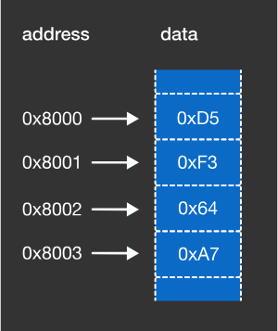

Slide 37
We often use hexadecimal for data. The beginning address of the tape (or memory) is determined by the OS. For this example, the byte at the address 0x8000 contains the data 0xD5.
In modern computer architectures, one memory address points to one byte. Therefore, the address of the next byte is 0x8001, which contains the data 0xF3.
Programs access memory by running CPU instructions and specifying the target address. For example: read 1 byte from address 0x8000 write 2 bytes to address 0x8002 (this means 0x8002 and 0x8003).

Slide 38
When working with memory, we often use sizes that are 2 ^{N} for convention.
We use units like:
MB
(2 ²⁰ =1024×1024 bytes) or
GB
(2 ³⁰ =1024×1024×1024 bytes),
instead of the regular units like
MB (10⁶ bytes) or GB (10⁹ bytes).

Slide 39
Since one byte can hold values no larger than 255, we often work with integers that span multiple bytes to hold larger numbers.
For example, we need at least 2 bytes of memory to represent the number 43690, which is 0xAAAA in hexadecimal.

Slide 40
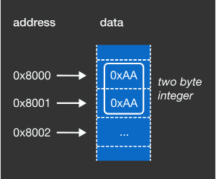
At least how many bytes of memory do we need to represent the decimal number 1,000,000,000?

Slide 41
Explanation
N bytes can represent values up to 2^{8N}−1. Thus,
1 byte can represent values up to 255.
2 bytes can represent values up to 65,535.
3 bytes can represent values up to 16,777,215.
4 bytes can represent values up to 4,294,967,295.
Since 3 bytes are not enough but 4 bytes are, we need at least 4 bytes.
Correct Answer:4 Bytes

Slide 42
Endianness:
Since each byte has a memory address, it’s worth asking: in what order do we store the bytes that compose a multi-byte integer?
Do we store the least-significant (rightmost) byte in the first memory address, or do we store the most-significant (leftmost) byte in the first memory address?
The answer is that it depends on the endianness of your computer’s architecture.
Storing the most-significant byte first is called big-endian. Storing the least-significant byte first is called little-endian.

Slide 43
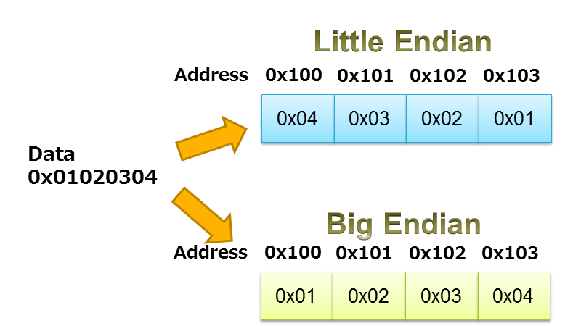
https://www.iar.com/support/resources/articles/migration-techniques-for-different-endianness/

Slide 44
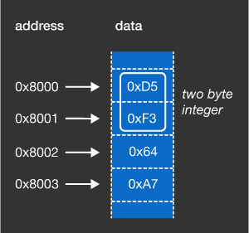
Given a little-endian computer architecture, and memory that looks like the above diagram, the address 0x8000 and 0x8001 together are used to describe a 2-byte integer. What is the integer in decimal (base 10)?

Slide 45
Correct answer: 62421
Explanation
The address 0x8000 contains 0xD5, and the address 0x8001 contains 0xF3.
Since the computer architecture is little-endian, the two-byte integer is 0xF3D5, which is 62421 in decimal.

Slide 46
The entire memory can be considered as a giant 1-dimensional tape of bytes. However, to make it easy to work with, we’ll often wrap it across multiple lines such that there are many bytes per line (often 16), and the memory address of the first byte on each line will be specified in a column to the left of the resulting table. To get the memory address of an arbitrary byte, look up the memory address of the first byte on that line, count the number of bytes to the left of the target byte, and add that number to the memory address of the first byte.
This method of displaying memory is called a hex dump and is quite common in debuggers, packet sniffers, hex editors and the like.

Slide 47
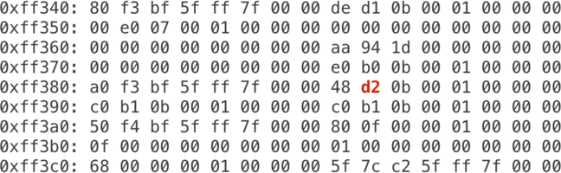
What is the memory address of the red bolded byte?

Slide 48
Correct answer: 0xff389
Explanation
The beginning address of the row is 0xff380.
The offset of the bolded byte is 9, since the position of a byte in a row is zero-indexed.
Therefore, the address of the target byte is 0xff380 + 9 = 0xff389.

Slide 49
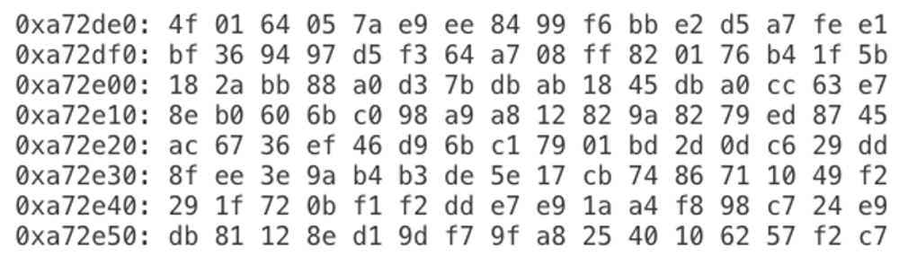
The x86-64 architecture is little-endian. Below is a memory dump from a computer running on this architecture:
What is the value of the 32-bit integer stored at memory address 0xa72e29?
Answer in decimal (base 10).

Slide 50
Correct answer: 221101313
Explanation
A 32-bit integer takes four bytes. The four bytes starting at address 0xa72e29 are 01, bd, 2d, 0d, each in hexadecimal.
Due to the architecture being little-endian, the integer is read as 0x0d2dbd01.
0x0d2dbd01 is 221101313 in decimal.

Slide 51
MEMORY LAYOUT
Powered by Brilliant App

Slide 52
we are going to see how variables in programs get placed in memory. We will use the programming language C for explanation. There are a few data types that represent integers in C, i.e. char, short, int, and long. The size of each data type depends on the compiler and computer architecture, but we will assume the following sizes here:
char … 1 byte short … 2 bytes int … 4 bytes long … 8 bytes

Slide 53
When programming, we need to decide on the size of the integer to use. We often use int, the default type, which has 4 bytes and can hold integers in the range about -2 billion to +2 billion, and this is enough for most cases. We use the other data types for situations where we want larger or smaller integers. For example, we use long when we need a variable that can hold numbers that are larger than 2 billion. We may use char or short when we want to save memory.

Slide 54
Question
What is the total amount of memory, in bytes, needed when allocating the following four variables?
char a;
short b;
int c;
long d;

Slide 55
Correct answer: 15
Explanation
1 + 2 + 4 + 8 =15.
The total memory needed is 15 bytes.

Slide 56
Let’s consider the memory of the following variables:
char a = 0x11;
short b = 0x2233;
int c = 0x44556677;
long d = 0x8899AABBCCDDEEFF;

Slide 57
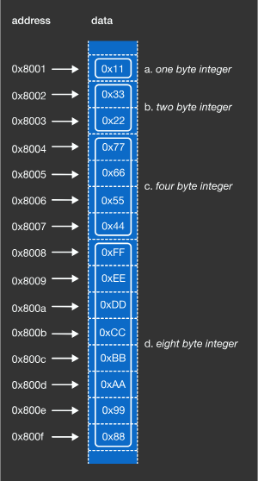
On an example environment, the memory layout may look like the following diagram:

Slide 58
In this example, the order of variables defined in the source code and the order of the data stored in memory matched each other.
Furthermore, the variables were placed next to each other in memory without any padding in between. However, in actual situations, the compiler may reorder variable allocation and add padding for optimization.

Slide 59
Mass Storage Devices

Slide 60
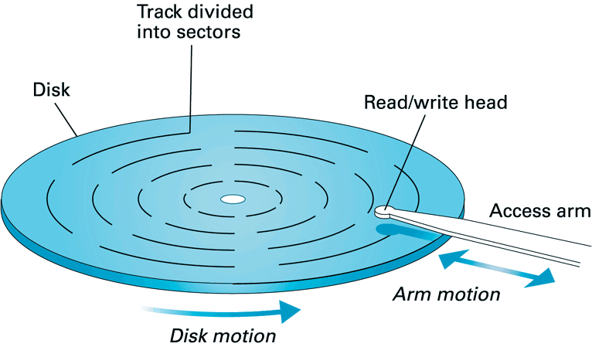
1.3 A Magnetic Disk Storage System
Each track contains same number of sectors
Sector Size -> 512 or 1024 KB
Location of tracks and sectors not permanent (formatting)
Examples: hard disks, floppy disks, Zip disks, ...
Evaluating disk’s performance: seek, latency and access times
transfer rate

Slide 61
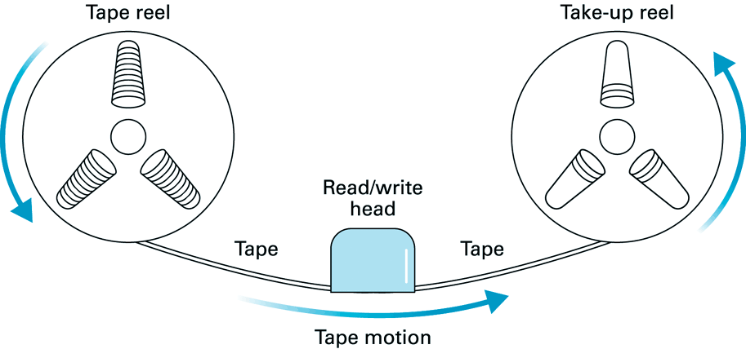
1.3 Old, but still commonly used: Magnetic Tape
Offers little or no random access (slow!)
Good choice for off-line data storage (archives)

Slide 62
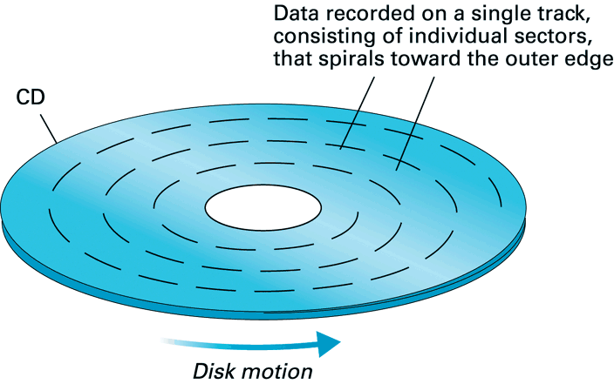
1.3 CD/DVD Storage Format
Data stored by creating variations in the reflective surface
Data retrieved by means of a laser beam
Data stored uniformly (so CD rotation speed varies)
Random access much slower than for magnetic disks

Slide 63
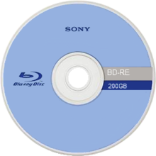

Media type High-density optical disc Capacity 25 GB (single-layer) 50 GB (dual-layer) 100/128 GB (BDXL) Block size 64 kb Usage Data storage High-definition video (1080p) High-definition audio Stereoscopic 3D PlayStation 3 games
The name Blu-ray Disc refers to the blue laser used to read the disc, which allows information to be stored at a greater density than is possible with the longer-wavelength red laser used for DVDs. The major application of Blu-ray Discs is as a medium for video material such as feature films.

Slide 64
1.3 Mass Storage
Main memory is volatile and limited in size
Additional memory devices for mass storage:
a.o.: magnetic disks, optical disks, magnetic tapes
Online and Offline Devices
Advantages over main memory:
less volatile, large capacity, capability of removal, generally much cheaper
Disadvantages over main memory
mechanical motion for data access/retrieval (Response time slow!)
in general: lesser degree of random access

Slide 65
File Storage and Retrieval
Storage in mass storage medium->Files
A block of data conforming to the physical characteristics of storing device is called Physical records.
A file usually has natural divisions determined by the information represented. It describes Logical records.
Problem: scattered data
Solution: Buffer
Degree of random access of the data

Slide 66
Any Questions?
Notes:
Reading
Richard Fayman -> Biography -> Interesting to read-> Physics lectures
Algorithms are eating our work-> Ted Talk.
Computer Limitations -> Travel’s sale man problem.
Contents are books, Grading -> not required
Less Text should be replaced by Images.
Slides makes students passive.

